Slide 1
Network Traffic Anomaly Detection using Machine Learning Intel Unnati AI/ML For Networking Project Submission
Presented by:
M.Eesha - BU22EECE0100424
B.Bharath Narasimha Sai - BU22EECE0100184
L.Mokshagna Reddy - BU22EECE0100089

Slide 2
Problem Statement
AI/ML for Networking
Category: Network Security
Pre-requisites:
Computer Systems Basics – CPU/Memory/Storage/NIC
Good Hands-on Experience on Linux
Programming Skills in Python and/or C
Basics of AI/ML

Slide 3
Solution Overview
We developed a supervised machine learning pipeline that:
Preprocesses structured network traffic data
Trains multiple classification models
Detects and classifies network anomalies
Visualizes performance and predictions This helps in real-time threat monitoring and improves embedded system security.

Slide 4
We built a supervised machine learning system to analyze and detect anomalies in network traffic.
• Data Preprocessing: Handles missing values, encodes categorical variables, scales features, and applies feature selection.
• Model Training: Trains models like Random Forest, XGBoost, SVM, Logistic Regression, and KNN on the processed data.
• Anomaly Detection: Models predict whether incoming traffic is normal or anomalous.
• Performance Visualization: Evaluation metrics like accuracy, F1 score, and ROC AUC are visualized using graphs.
This solution enables real-time threat monitoring and strengthens embedded system security.

Slide 5
Features Offered
Preprocessing of raw network data
Feature selection using ANOVA F-score
Training with multiple ML models (RF, XGBoost, SVM, etc.)
Visual performance metrics (confusion matrix, ROC curves)
Future scope for real-time detection and deployment on edge devices

Slide 6
Process Flow
Load Dataset
↓
Preprocess Data
↓
Feature Selection
↓
Train Models
↓
Evaluate Results
↓
Visualize Insights

Slide 7
Dataset Used:
Network Traffic Anomaly Detection
100K+ rows of labeled traffic data
Binary classification: Normal vs Anomalous
Feature-rich and suitable for embedded network simulations

Slide 8
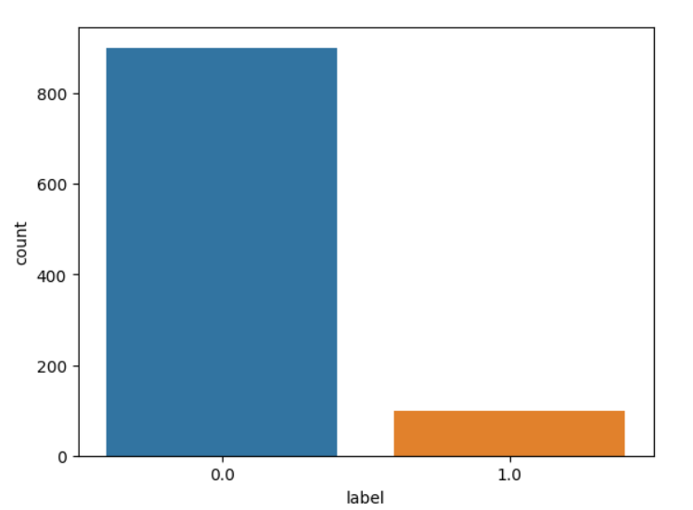
Sample Results

Slide 9
